Slide 1

Rockbuster Stealth LLC
Kaan arslan

Slide 2
Key Questions
Which movies contributed the most/least to revenue gain?
What was the average rental duration for all videos?
Which countries are Rockbuster customers based in?
Where are customers with a high lifetime value based?
Do sales figures vary between geographic regions?

Slide 3
Current Statistics
Maximum
Rental rate: $4.99
Rental duration: 7 days
Film length: 185 min
Replacement cost: $29.99
Average
Rental rate: $2.98
Rental duration: 5 days
Film length: 115 min
Replacement cost: $19.98
Minimum
Rental rate: $0.99
Rental duration: 3 days
Film length: 46 min
Replacement cost: $9.99
- Neil Armstrong

Slide 4
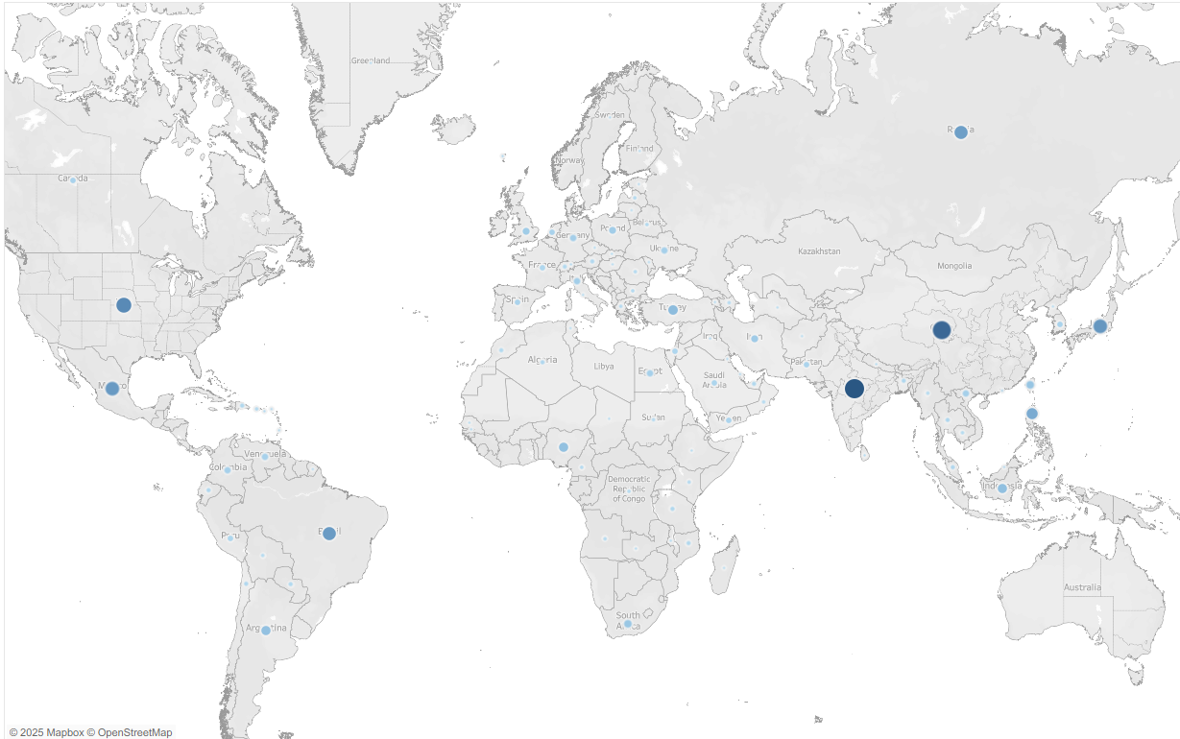
This map displays the number of customers worldwide. Larger and darker bubbles indicate countries with a higher customer count. The top five countries in terms of customer volume are India, China, the USA, Japan and Mexico.
In addition to these, countries with potential that should be considered for further focus Brazil, Russia, the Philippines and Turkey.
- Neil Armstrong

Slide 5
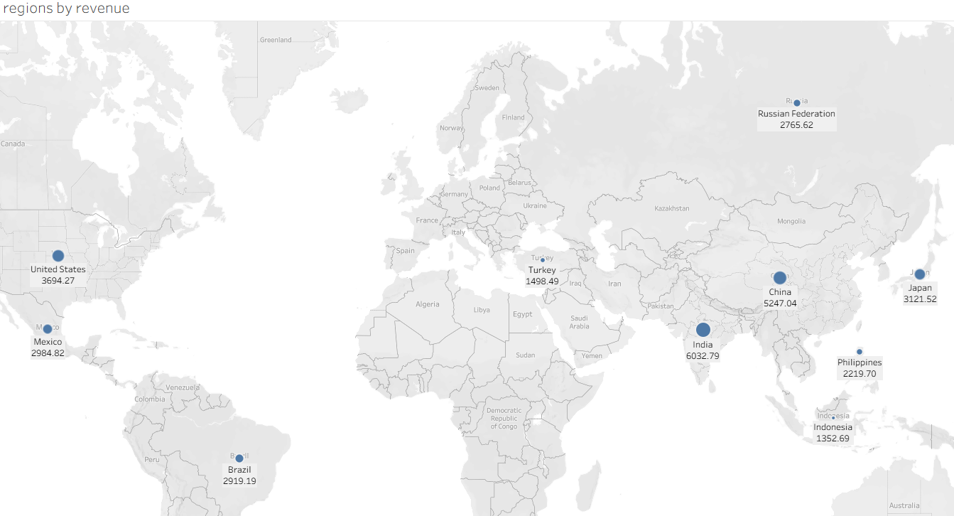
This map shows the top 10 countries by revenue, indicating how much was earned from each. Top three countries are India, China and United States.
It provides insights into where the company might consider investing in the future.
- Neil Armstrong

Slide 6
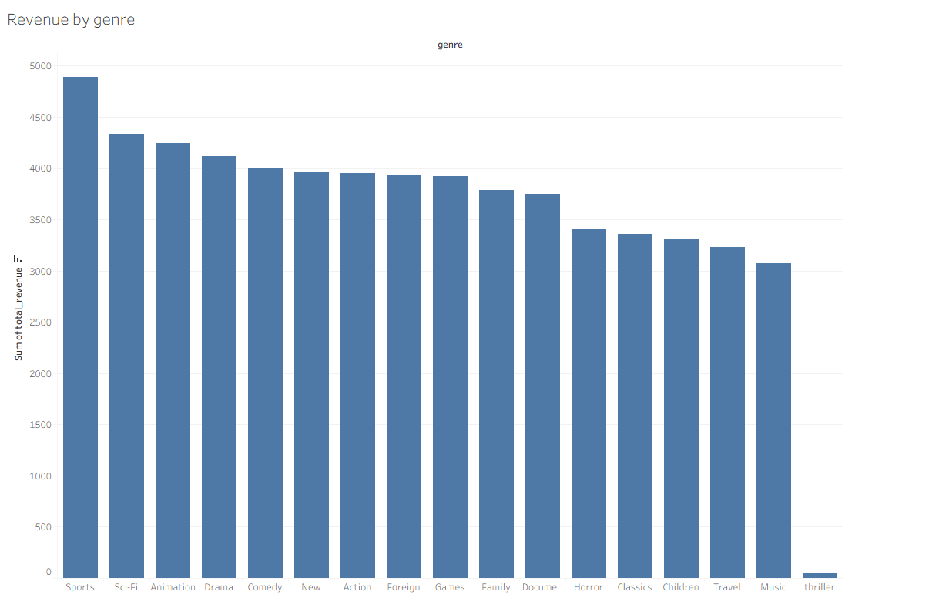
The chart shows that the top three revenue-generating genres are sports, sci-fi, and animation. Investments in these genres are yielding results and can be continued and further developed.
- Neil Armstrong

Slide 7
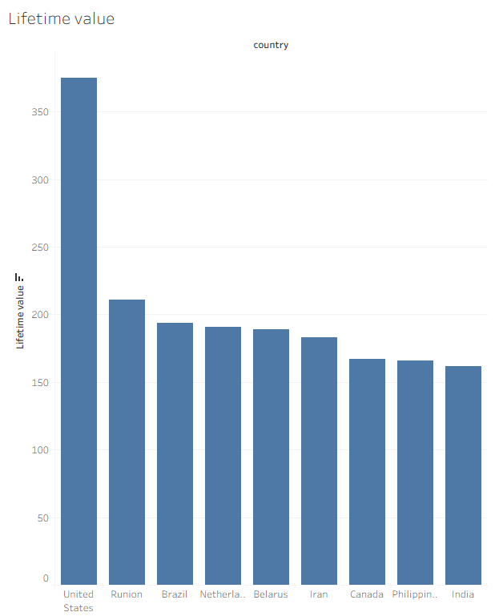
Lifetime value
The lifetime value analysis shows which customers have generated the highest total revenue over time. It helps identify the most valuable customers and where they are located
- Neil Armstrong

Slide 8
Insights and recommendations
Insights
Revenue is highly concentrated in a few key regions with countries like the USA, India, China, Japan, and Mexico generating the highest returns.
Top three popular genres are sports, sci-fi and animation
While top countries have the most customers emerging markets like Brazil, Russia, the Philippines, and Turkey show growing potential.
High-LTV customers are mainly located in the USA, Runion,Brazil and The Netherlands. (USA has 2 customers)
- Neil Armstrong

Slide 9
Recommendations
Maintain strong presence and marketing efforts in the regions that are already have higher revenues. Additionally, explore localized campaigns or partnerships to further boost engagement in top-performing markets.
Offering region-specific recommendations can improve user experience and increase rentals.
Implement loyalty programs or premium offerings targeting to high-value customers in USA, Brazil and The Netherlands. Retaining them is significantly more cost-effective than acquiring new customers.
Consider targeted expansion or marketing efforts in the potential countries like (Turkey, Brazil and Russia) to tap into new customer bases with increasing interest in digital rentals.
- Neil Armstrong

Slide 10
Thank You
Kaan Arslan

